Slide 1
Quiz on Lecture 4
Please receive the quiz handout from Cyrille, Oliver, Vincent, Jan
Complete the quiz in silence
Hand the quiz back

Slide 2
Quiz on Lecture 4
What is the primary goal of Continuous Integration (CI)?
  To automatically deploy every change directly to production.
  To frequently run automated tests and merge code to create a tight feedback loop.
  To provision and manage infrastructure through code.
  To package applications into Docker containers for deployment.
In GitHub Actions, what is a 'Job'?
  A collection of steps that execute on the same runner.
  An individual task, such as running a single shell command.
  A reusable, community-built unit of code that performs a complex task.
  The trigger for the entire workflow, such as a push or pull request.
Which of the following is NOT a task typically automated in a CI pipeline for code quality checks?
  Performing static analysis to find potential bugs.
  Running unit and integration tests with pytest.
  Linting the code for stylistic errors.
  Pushing the Docker image to a container registry.
What is the main purpose of a Container Registry like Google Artifact Registry (GAR)?
  To store and manage Docker images.
  To run automated tests on the code.
  To monitor the performance of live applications.
  To write and version infrastructure code.
What best describes the function of code in the workflow yml
on:
push:
branches: [ development ]
Branches pushed to development will be ignored
Run the job when a pull request is made to the development branch
Run the job when a PR is merged to the development branch
Development changes are ready when a push is made

Slide 3
Quiz on Lecture 4 (Answers)
what is the primary goal of Continuous Integration (CI)?
  To automatically deploy every change directly to production.
  To frequently run automated tests and merge code to create a tight feedback loop.
  To provision and manage infrastructure through code.
  To package applications into Docker containers for deployment.
In GitHub Actions, what is a 'Job'?
  A collection of steps that execute on the same runner.
  An individual task, such as running a single shell command.
  A reusable, community-built unit of code that performs a complex task.
  The trigger for the entire workflow, such as a push or pull request.
Which of the following is NOT a task typically automated in a CI pipeline for code quality checks?
  Performing static analysis to find potential bugs.
  Running unit and integration tests with pytest.
  Linting the code for stylistic errors.
  Pushing the Docker image to a container registry.
What is the main purpose of a Container Registry like Google Artifact Registry (GAR)?
  To store and manage Docker images.
  To run automated tests on the code.
  To monitor the performance of live applications.
  To write and version infrastructure code.
What best describes the function of this code in a workflow yaml
on:
push:
branches: [ development ]
Branches pushed to development will be ignored
Run the job when a pull request is made to the development branch
Run the job when a PR is merged to the development branch
Development changes are ready when a push is made

Slide 4
Designing and Deploying
end-to-end
Production Grade ML Applications
Lecture 5: Steamlit & Gradio
October 2025
Cyrille Feudjio & Oliver Angélil

Slide 5
Contents of this lecture
Why Build Interfaces for ML Models?
Popular Tools
Deep Dive: Streamlit
Deep Dive: Gradio
Streamlit vs. Gradio: Key Differences
When to Use Which?
Conclusion & Key Takeaways

Slide 6

1. Why Build User Interfaces (UIs) for ML Models?
Making models accessible to non-technical users.
Facilitating demos and presentations.
Gathering feedback and data.
Rapid prototyping and iteration.
Bridging the gap between model development and user value

Slide 7
2. Popular Tools
Tool | Highlights | Best For
Streamlit | Easiest to turn Python scripts into web apps | Prototypes, dashboards, internal tools
Gradio | Instant model demos with input/output UI | Sharing ML models, testing models
Dash | Plotly-based; great for analytics dashboards | Complex visualizations, production apps
FastAPI + Frontend (React/Vue) | API backend for ML models | Scalable web apps, full production deployments
Voila | Turns Jupyter Notebooks into apps | Notebook-based workflows
Panel | Supports rich layouts and streaming data | Scientific visualizations
Flask | Classic Python web framework | Custom UI + ML serving
Pynecone (reflex) | New framework for fullstack apps with Python | Modern interactive web apps

Slide 8
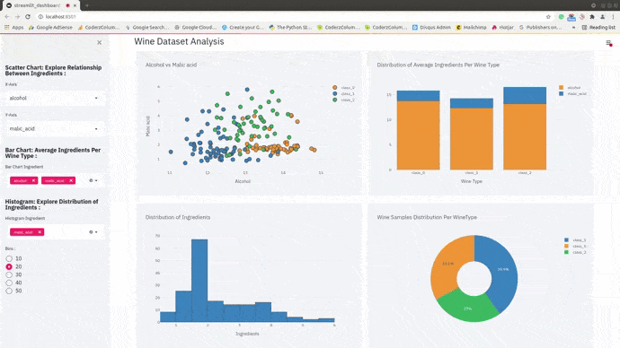
3. Deep Dive: Streamlit
Turn Scripts into Shareable Web Apps
Streamlit is an open-source Python framework designed to transform data scripts into interactive web applications effortlessly.
Key Features:
  Pure Python
  Rapid Development: Build and iterate apps quickly with hot-reloading.
  Interactive Widgets: Easily add sliders, buttons, and more to your app.
  Seamless Integration: Compatible with popular libraries like Pandas, NumPy, Matplotlib, and Scikit-learn.
  Deployment Options: Deploy apps on Streamlit Community Cloud or integrate with platforms like AWS and Heroku.
  Feels like writing a Python script

Slide 9

3. Deep Dive: Streamlit
Pros & Cons
Ease of Use: Simplifies the process of creating web apps for ML models
Rapid Prototyping: Quick turnaround from model to deployable app
Interactive Visualizations: Built-in support for charts and plots.
Community Support: Active community with numerous tutorials and examples.
Limited Customization: Less flexibility compared to full-stack frameworks.
Performance: May not be optimal for handling high-traffic applications.
Session Management: Limited control over user sessions and authentication.

Slide 10
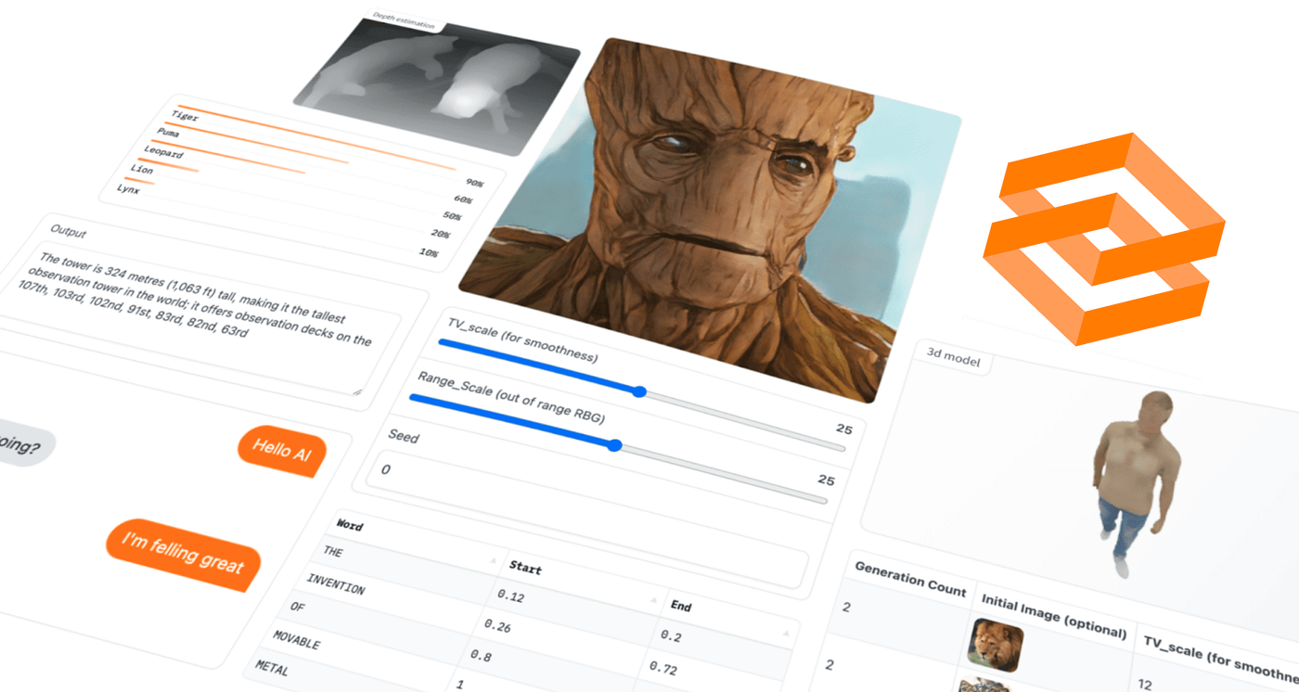
4. Deep Dive: Gradio
Create Demos & Interfaces for ML Models Quickly
Gradio is an open-source Python library that lets you create beautiful, interactive UIs for ML models easily.
Designed to make model sharing, testing, and feedback collection simple and fast.
Key Features:
  Minimal Code: Wrap any function with a UI using just a few lines.
  Flexible Inputs/Outputs: Text, image, audio, video, file upload, and more.
  Instant Sharing: Generate a shareable public link automatically.
  Integration Ready: Easily integrate with TensorFlow, PyTorch, etc.
  Collaborative: Let users interact and test your models live.

Slide 11
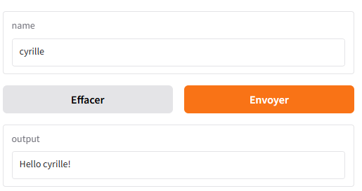
4. Deep Dive: Gradio
Code Example
#example.py
import gradio as gr
def greet(name):
return "Hello " + name + "!"
demo = gr.Interface(fn=greet, inputs="textbox",
outputs="textbox",
allow_flagging="never" # "manual"
)
if __name__ == "__main__":
demo.launch(share=True)
clear
Send
This is a regular python file that you can just run with the python interpreter
$ python example.py

Slide 12
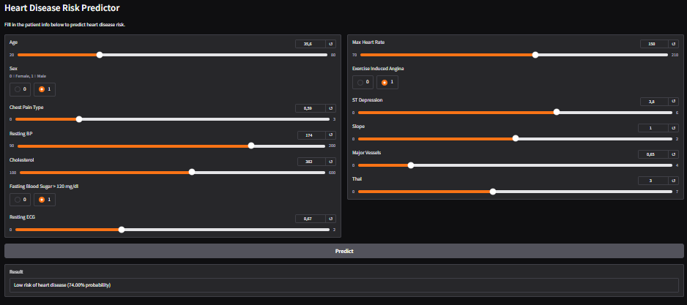
4. Deep Dive: Gradio
Code Example: code here

Slide 13
4. Deep Dive: Gradio
Pros & Cons
Fast Setup: Get a live interface running in minutes.
Public Sharing: Auto-generate shareable links for easy collaboration.
Customizable Inputs/Outputs: Handle text, images, audio, video seamlessly.
Lightweight: No need to build or host complicated frontends.
Basic Layout Options: Less control over complex UIs or multi-step workflows.
Limited Scalability: For large, high-traffic apps, you might need to combine it with bigger frameworks.
Customization Limits: Less flexibility for heavy frontend design.

Slide 14
5. Streamlit vs. Gradio: Key Differences
Feature | Streamlit | Gradio
Main Purpose | Build full interactive apps | Create model demos and interfaces
Ease of Setup | Very easy (Python script) | Extremely easy (1–2 lines for interface)
Customization | High (layouts, charts, components) | Moderate (custom inputs/outputs)
Best For | Dashboards, data apps, internal tools | Quick ML demos, user input testing
Deployment | Streamlit Cloud, AWS, GCP | Instant public links
Session/User Management | Limited (needs add-ons for auth) | Basic (mostly for demos, not auth-heavy)

Slide 15
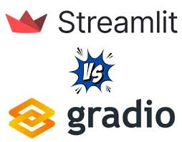
6. When to Use Which?
Choose Streamlit if:
You want to build full apps with dynamic pages and dashboards.
You need more control over app layout and UI components.
Choose Gradio if:
You need a fast ML demo with minimal code.
You want to share a model publicly without setting up servers.

Slide 16
Conclusion & Key Takeaways
Both are powerful, Pythonic tools to bridge the gap between ML models and users.
Streamlit excels at data-centric applications and offers more layout control.
Gradio excels at rapid model demo creation, and easy sharing.
Choice depends on the specific project requirements.
Both can be containerized and deployed as part of a production workflow.

Slide 17
Q&A
Questions?

